Slide 1

Predictive Analytics for Software Project Management
Mattia Tritto Rossella Tritto

Slide 2


Topic Description
Objective: Develop a predictive analytics system for improve planning and management of software projects.
Key Features:
Use historical data (project duration, costs, resources).
Machine Learning Models: Regression and decision trees.
Outcome: Web application to display predicted project metrics.

Slide 3





Methodology
Paper Research & Dataset Screening
Machine Learning Model
Inferface
Containerization
Cloud Deploy
Study of the related work to understand existing solutions and dataset extraction
Encapsulation into a container for replication and dependencies management
Deploy on GCP for remotely access and easy updates and maintenance.
Find best configuration of different models
Streamlit interface to interact with the ML model

Slide 4
Background
1980s-1990s Traditional Models Focus on foundational cost estimation
2000s Estimation Accuracy Addressing biases and challenges
2010s Machine Learning Advances Improving predictions with neural networks
2020s Large Language Models Enhanced predictions for complex projects

Slide 5

Machine Learning Model
1
INITIAL Findings
Unified dataset yielded low R² (0.24), highlighting dataset heterogeneity issues
Focus shifted to the CHINA dataset (highest R² in trials)
2
Feature engineering
Selected key features: AFP, Effort, Input, Output, Enquiry, File Interface
Normalized using Median and IQR for effective preprocessing
Best model
3
Random Forest Regressor:
Best R²: 0.89 (balanced accuracy and generalizability)
Parameters: Tree Depth = 20, Min Samples/Leaf = 1, n_estimators = 130
4
Deployment
Model saved with Joblib for real-time predictions
Stored Median & IQR for consistent input preprocessing

Slide 6
Functional Requirements
Data Input
Accepts data like input/output values, logic files, GSC values, and developer count.
Data Processing
Calculates AFP and predicts outcomes using machine learning models.
Result Display & Export
Presents results in graphs/tables and generates customizable DOCX reports for PDF conversion.

Slide 7







Non-Functional Requirements
Performance <0.5s latency; GCP-hosted for low-latency services; Streamlit-powered frontend.
Portability Dockerized components ensure easy migration across cloud platforms
Scalability Cloud-native microservices architecture supports dynamic scaling
Security Input validation via Pydantic; logs requests; dependency audits conducted
Maintainability Loosely coupled microservices for independent updates
Usability Intuitive interface for minimal learning curve
Reliability Automated unit testing ensures consistent performance

Slide 8
Technology Stack
Frontend
Backend
Machine Learning
Containerization
Cloud Deploy
Streamlit Used for building the user interface, allowing for interactive data visualization and easy deployment of web applications
FastAPI Web framework for building APIs with Python facilitating efficient communication between the frontend and backend
scikit-learn
Library for ML in Python, used for developing predictive models, including regression and random forest
Docker
Used for creating a container for each service, ensuring consistent environments for development and deployment
Google Cloud Platform
Used to make the application cloud-native and allows to access it remotely by users, enhancing its accessibility

Slide 9




DevSecOps Principles
Testing
Unit tests for prediction endpoints and static file serving
Security
Logging for audit trails
Input validation with Pydantic models to enforce constraints
Containerization
Dockerized application ensures consistent deployment
Code Formatting
Integrated Black formatter for uniform code style across developers

Slide 10
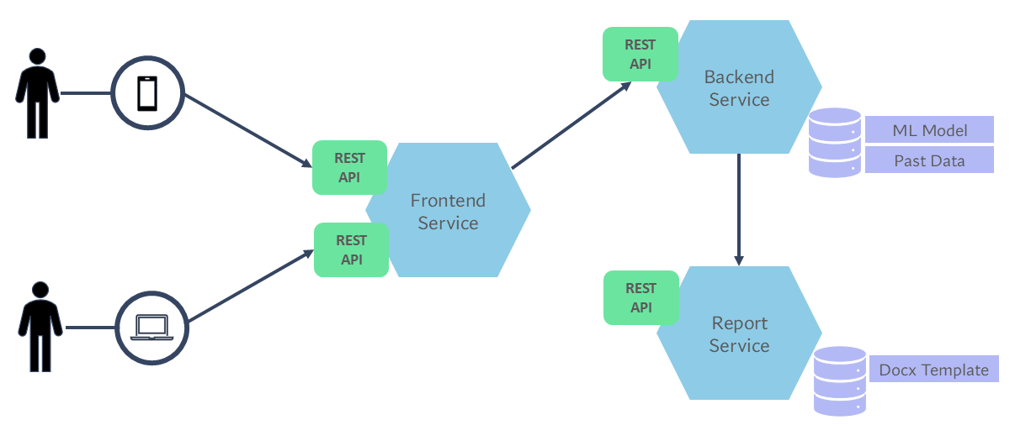
Software Architecture

Slide 11
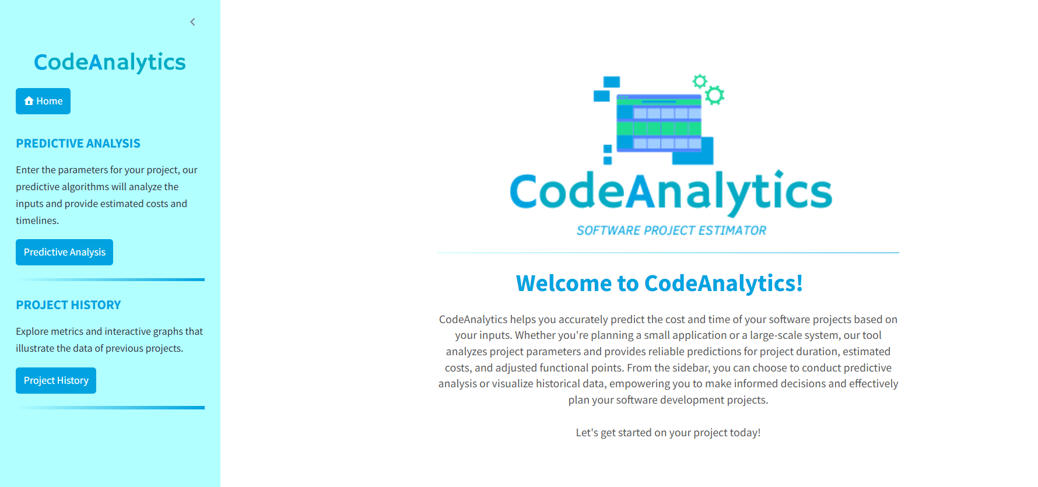
Frontend Service Structure
Home Page: Landing page with app introduction and logo
Predictive Analysis Page:
Inputs: EI, EO, EQ, ILF, EIF, developers, hourly wage, start date and 14 factors for computing AFP
Outputs: Predictions for cost, duration, AFP and end date
Visuals: Timeline graph for project schedule
Report: DOCX report with cost estimates, project details, and predictions
Project History Page:
Summary statistics for historical projects (EI, EO, etc.)
Graphs: AFP vs. Duration, histograms of AFP and duration

Slide 12
Backend Service Structure
Key Functionalities:
/predict: Predicts cost, duration, AFP from user inputs (via POST).
/data: Provides historical data in CSV format for interactive graphs.
/report: Generates DOCX reports and forwards them to the frontend.
Validation:
Pydantic models ensure valid input data.
Core Utilities:
calculate_afp: Computes AFP based on inputs.
predict_duration_and_costs: Loads ML model for predictions.

Slide 13
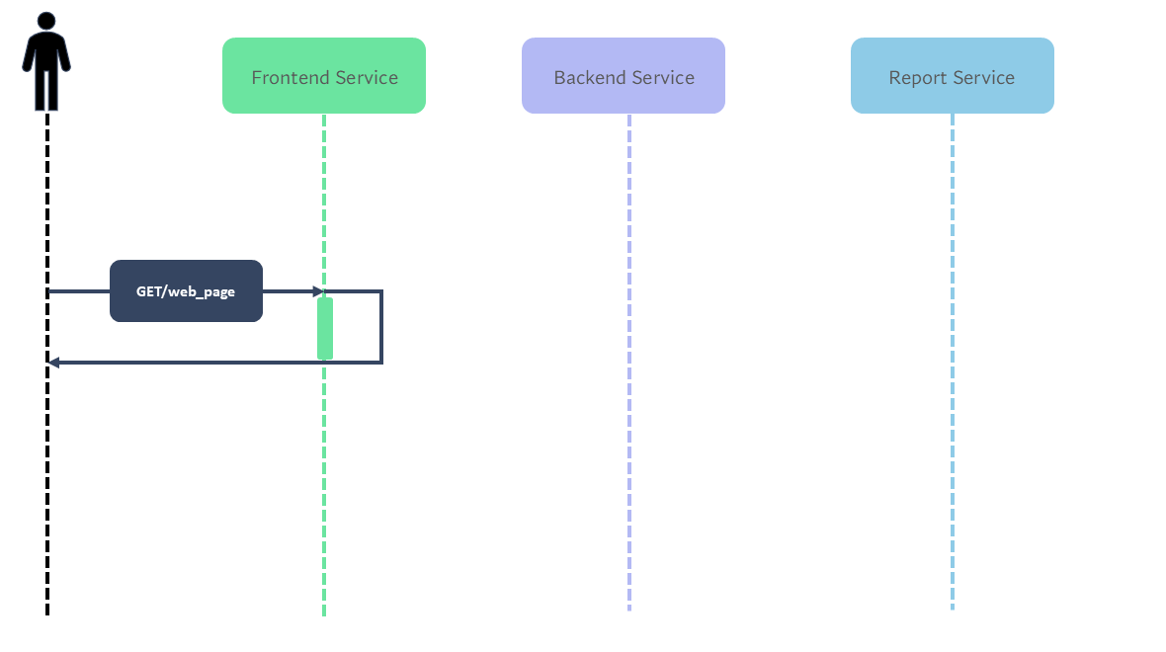
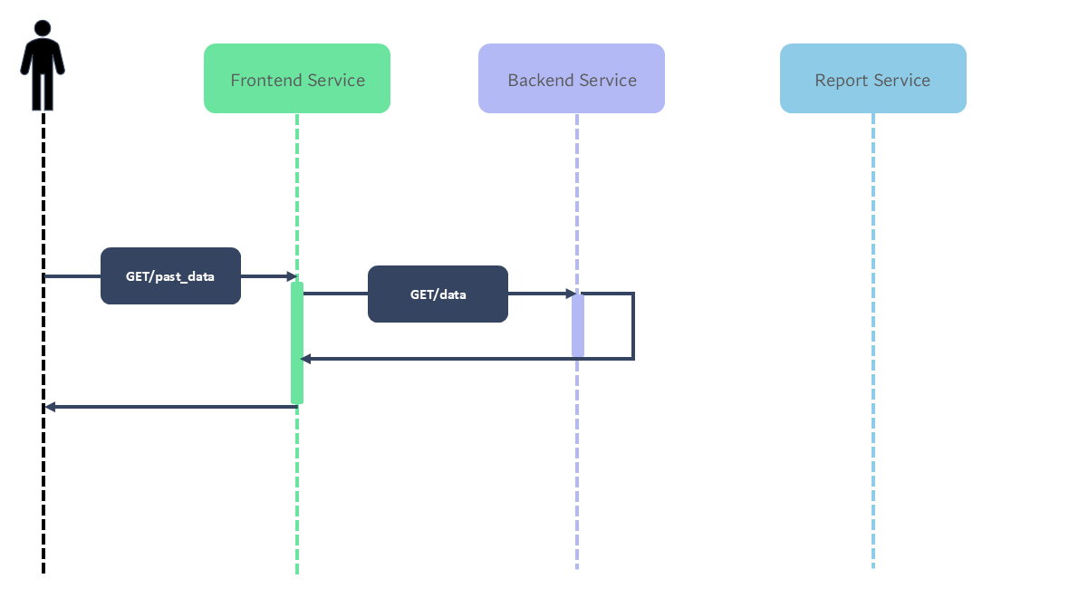
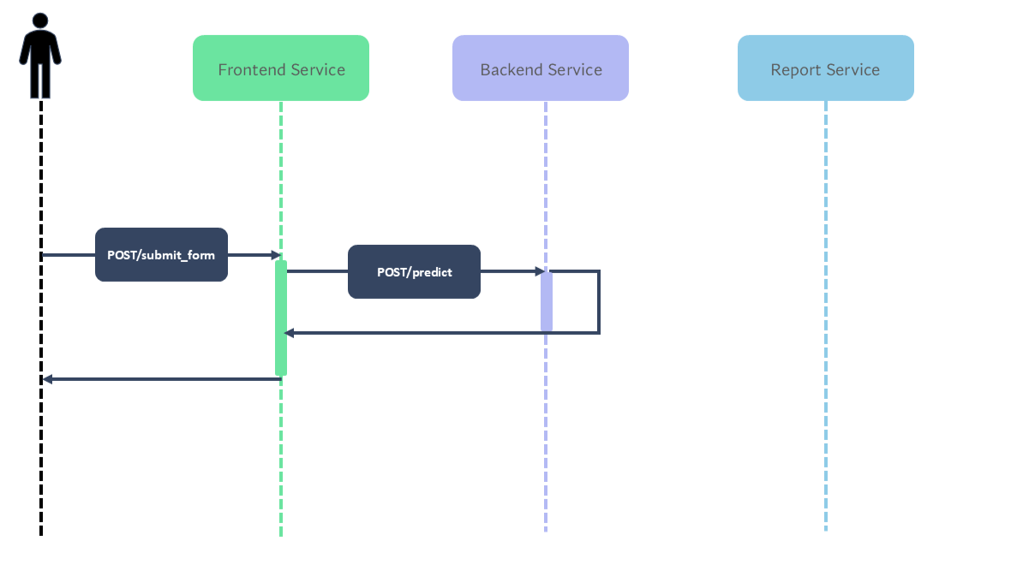
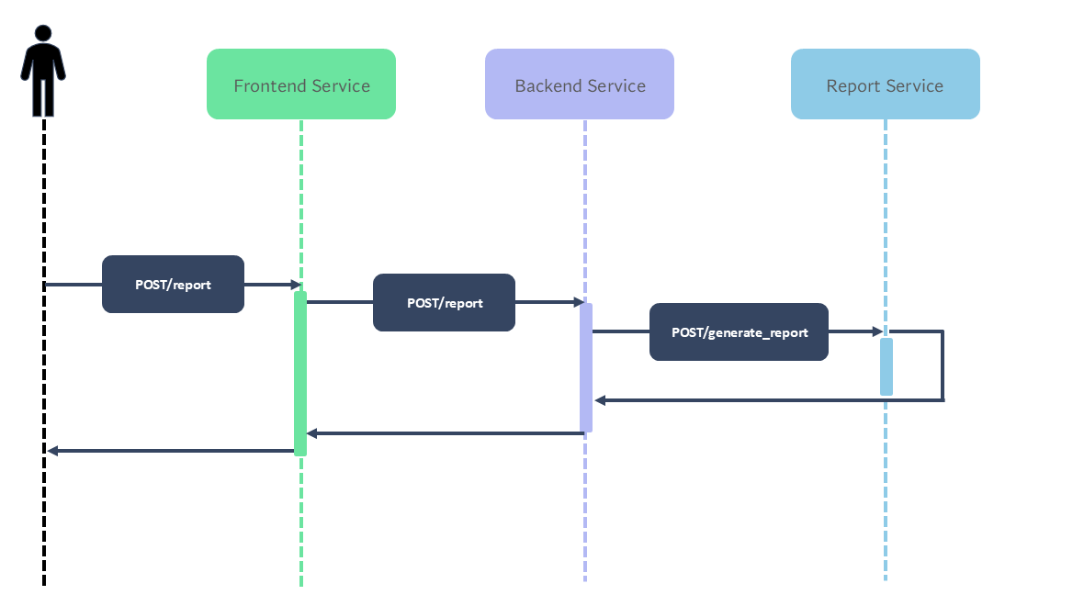
Sequence Diagrams

Slide 14

Let’s Dive In!
CodeAnalytics

Slide 15
Challenges
1. DATASET Difficulty finding suitable datasets with consistent and relevant features
2. HYPERPARAMETERS Identifying the right parameters for the machine learning model
3. DOCKER Creating a container for the server deployment

Slide 16



Project Conclusion
Project Requirements: Fulfillment of all specified functional and nonfunctional requirements
Approach: Efficiency of top-down approach to better manage each component
Architecture: Microservices architecture to facilitate team members working on different components simultaneously
Performance: Predictions reliable → R² Score = 0,89 for Random Forest

Slide 17
Future Work
Real-World Integration Deploy the software in an actual organization to evaluate and refine its capabilities in a practical context.
1
Customized Predictive Models Tailor the application to specific organizational datasets to enhance prediction accuracy and relevance.
2
Feature Expansion Incorporate additional industry-specific variables and qualitative factors for a more holistic analysis of project outcomes.
3

